Slide 1
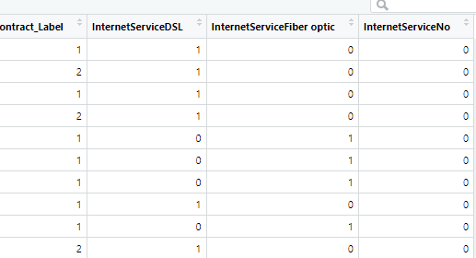
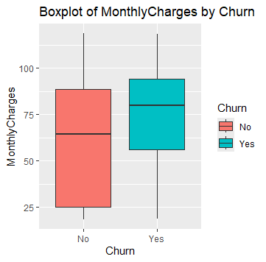
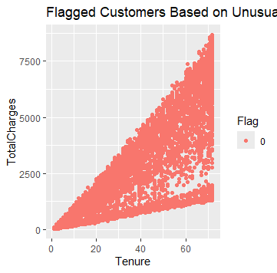
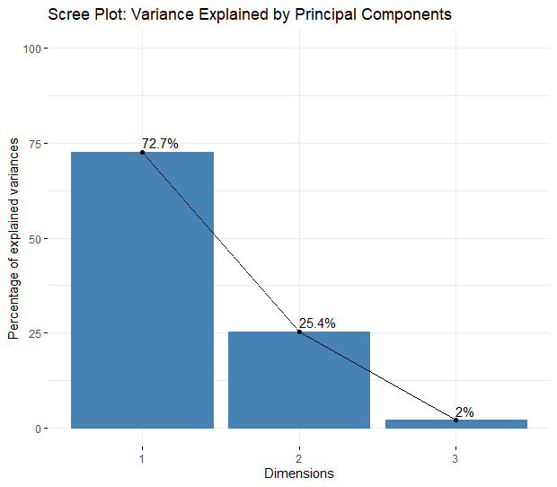
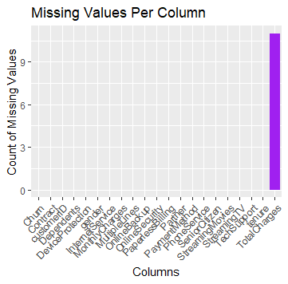
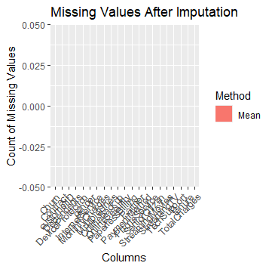
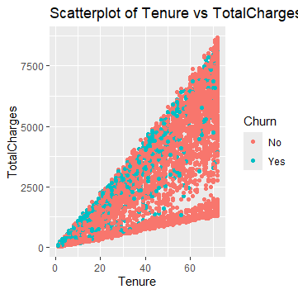
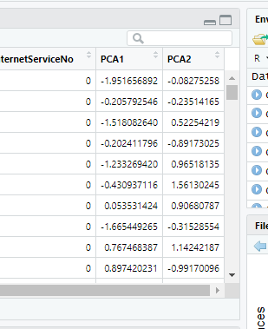
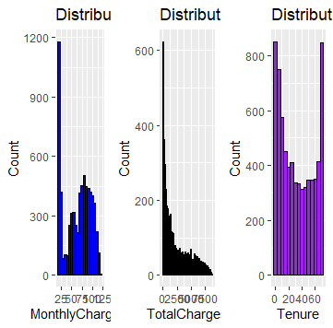
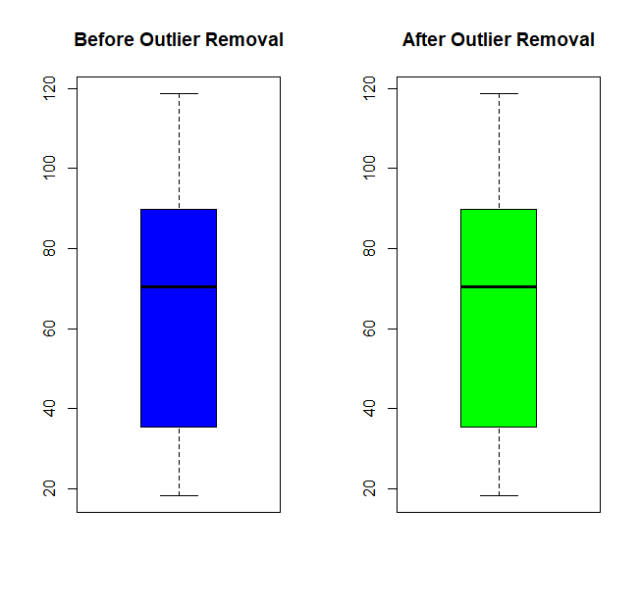
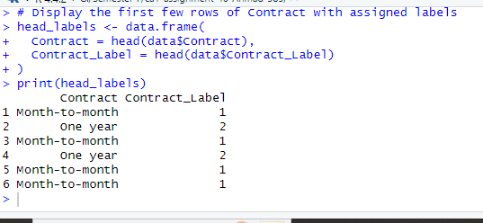
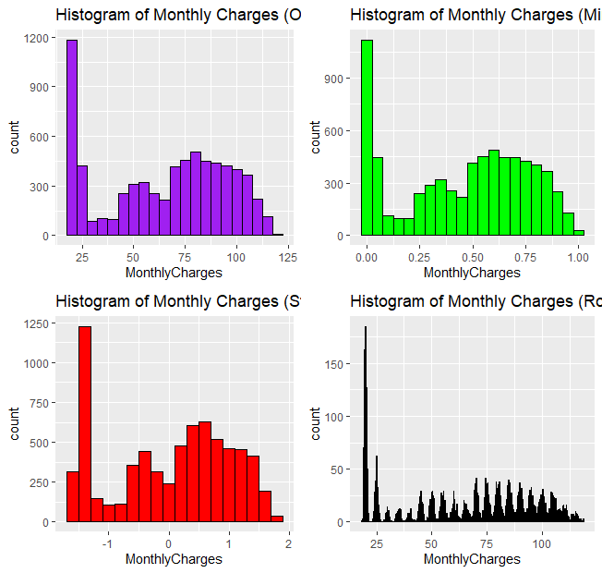
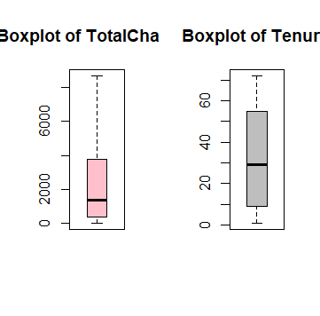

Exploration and Preperation of Telco Customer Churn Dataset
Muhammad Ahmad, 2021385 ,CCT College Dublin , November 2024
Github Link:https://github.com/CCT-Dublin/ca1-assignment-40-Ahmad-385
Motivation
Size & Attriibutes:
Before Cleaning:
Dataset dimensions: 7,043 rows × 21 columns
Missing values detected in TotalCharges.
After Cleaning:
Dimensions reduced to 6,981 rows × 20 columns
Missing values handled, irrelevant columns removed, and new features added.
Co- Variations:
Q: How does MonthlyCharges vary with Churn?
One-hot encoding
This study focuses on telecom churn analysis, analyzing consumer behavior to improve customer loyalty and optimize services in competitive markets. It identifies factors like tenure, charges, and service preferences, aiming to develop solutions to reduce churn and enhance customer satisfaction.
The boxplot shows that customers who churn ("Yes") tend to have slightly higher median monthly charges compared to those who do not churn ("No"). Additionally, the range of monthly charges for customers who churn is slightly narrower, indicating potential clustering at higher charges.
Dataset Overview
Exploratory Data Analysis(EDA)
The study uses the Telco Customer Churn Dataset, a dataset of 7043 telecommunication customers, with 21 independent variables including gender, tenure, contract type, payment method, internet service, and monthly charges. The dependent variable, 'Churn', indicates customer activity. This dataset is essential for predictive modeling and EDA, providing a comprehensive overview of customer behavior.
Q:Are there any customers flagged with unusual patterns based on specific conditions?No customers were flagged
Variance by PC
Data Cleaning and Preperation
Q:Are there clusters or gaps in MonthlyCharges or tenure?The scatterplot shows a clear positive relationship between tenure and TotalCharges. While no distinct clusters are evident, gaps in the data occur at lower tenure values with TotalCharges around zero, potentially indicating initial stages of customer relationships.
Missing Values: The metrics categorized by the VALUE columns were cross-checked for missing data and completed using imputation options like mean, median, and mode.
Variations:
Q: What is the distribution of MonthlyCharges, TotalCharges, and tenure?
he distribution of MonthlyCharges shows multiple peaks, indicating different pricing tiers. TotalCharges is positively skewed, while tenure displays distinct peaks, reflecting varying contract durations or churn patterns.
Map PCA results to the original dataset
Outliers: There is no outlier in this dataset Thats why befor & After graph plotted is aame.
Principal Component Analysis(PCA)
Label Encoding
CONCLUSIONS
Missing values were effectively handled using mean and mode imputation, ensuring data completeness.
Outliers were identified and addressed, maintaining data integrity for accurate analysis.
Key patterns, such as higher churn rates linked to higher MonthlyCharges and shorter tenures, were uncovered through EDA.
Scaling and normalization of numeric features ensured consistency for robust statistical analysis.
Principal Component Analysis highlighted significant features, reducing dimensionality while retaining essential variance.
Insights gained support data-driven strategies for improving customer retention and reducing churn.
Scaling & Normalization:Data preprocessing included Z-score scaling, Min-Max normalization, and Robust scaling for VALUE, visualized via distribution histograms. These techniques ensured consistent scaling for statistical analysis.
Q:: Are there any outliers in these features?
The boxplots suggest that TotalCharges may contain potential outliers, indicated by data points beyond the whiskers. However, tenure appears to have no outliers as the distribution is contained within the whiskers.
label-encoded 'Contract'
REFERENCES
R Core Team. “R: A Language and Environment for Statistical Computing.” R Foundation for Statistical Computing, 2024, www.r-project.org/.
Silver Fox Data. “Predicting Customer Churn in R.” YouTube, 11 Dec. 2020, www.youtube.com/watch?v=_2V_WwJTGpE. Accessed 24 Nov. 2024.
“Telco Customer Churn.” Www.kaggle.com, www.kaggle.com/datasets/blastchar/telco-customer-churn/data.
tsogoo bataa. “Data Analysis Using R Programming (Teleco Customer Churn Rate).” YouTube, 10 Mar. 2023, www.youtube.com/watch?v=49oHXdRzwF4. Accessed 24 Nov. 2024.

